Slide 1
Data Visualization:
Global University Rankings
Sarah Buckingham and Kevin Hennessey

Slide 2
Introduction
An investigation into the relationships of university ranking metrics and the nations which host those universities
Utilize Kaggle dataset for university ranking information
Incorporate visualization methods and interaction capabilities to answer questions surrounding global university rankings

Slide 3
Tasks
What is the ratio of ranked institutions of higher education by country?
Which institutions are commonly ranked highest according to varying criteria?
What nations have the best institutions of higher education based on Highest ranking, average ranking, and lowest ranking?
What specific Institutions are lacking or excelling in terms of quality of education, faculty, number of publications or citations?
Notes:
Here are some examples of tasks we would want to accomplish with our visualization that could be of interest to potential students, faculty members, and researchers.
Components:
institution name, country of location, world ranking, national ranking, ranking by quality of education, ranking by faculty, ranking by publication, and ranking by university population
Each of these rankings will be coordinated by the country in which the institution resides. This aspect proposes a problem when a country has multiple universities within the top 1024 world-wide. Coordinating by home country also forgoes being able to investigate the individual institutions which rank the highest. So, in addition to having a geographic map encoded with data values, our visualization will have a secondary aspect which shows institutional rankings.

Slide 4
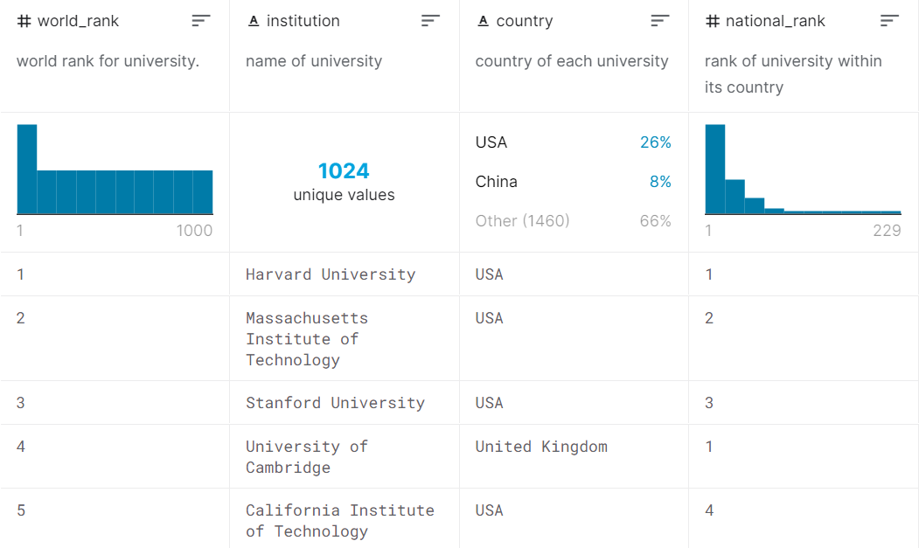
Dataset Background
Compiled through multiple university ranking systems in 2015
Displays the top 1000 universities worldwide as well as the country in which they reside
Provides other types of ranking information as well
Source: Kaggle.com
Notes:
The Times Higher Education World University Ranking, Shanghai Ranking, etc.
Other rankings include the national ranking, ranking based on quality of education, ranking based on quality of faculty, or ranking based on the number of students

Slide 5
Method
Develop a visualization that encodes ranked data onto a geographic map
Develop a secondary list aspect which shows institutional rankings independent of map location
For the geographic map, ranking values will be displayed through luminance; the ranking will also be demonstrated by position within the subplot visualization
Notes:
Components:
institution name, country of location, world ranking, national ranking, ranking by quality of education, ranking by faculty, ranking by publication, and ranking by university population
Each of these rankings will be coordinated by the country in which the institution resides. This aspect proposes a problem when a country has multiple universities within the top 1024 world-wide. Coordinating by home country also forgoes being able to investigate the individual institutions which rank the highest. So, in addition to having a geographic map encoded with data values, our visualization will have a secondary aspect which shows institutional rankings.

Slide 6
Implementation
Utilize Excel and R for data cleaning and manipulation
Development of our visualization will be completed utilizing D3
world map using GeoJSON
calculate statistical measures
interaction component with drop-down menu
list feature below also follows drop-down direction
Notes:
We have already pre-processed the data so that a country’s unique code is present within the data.

Slide 7
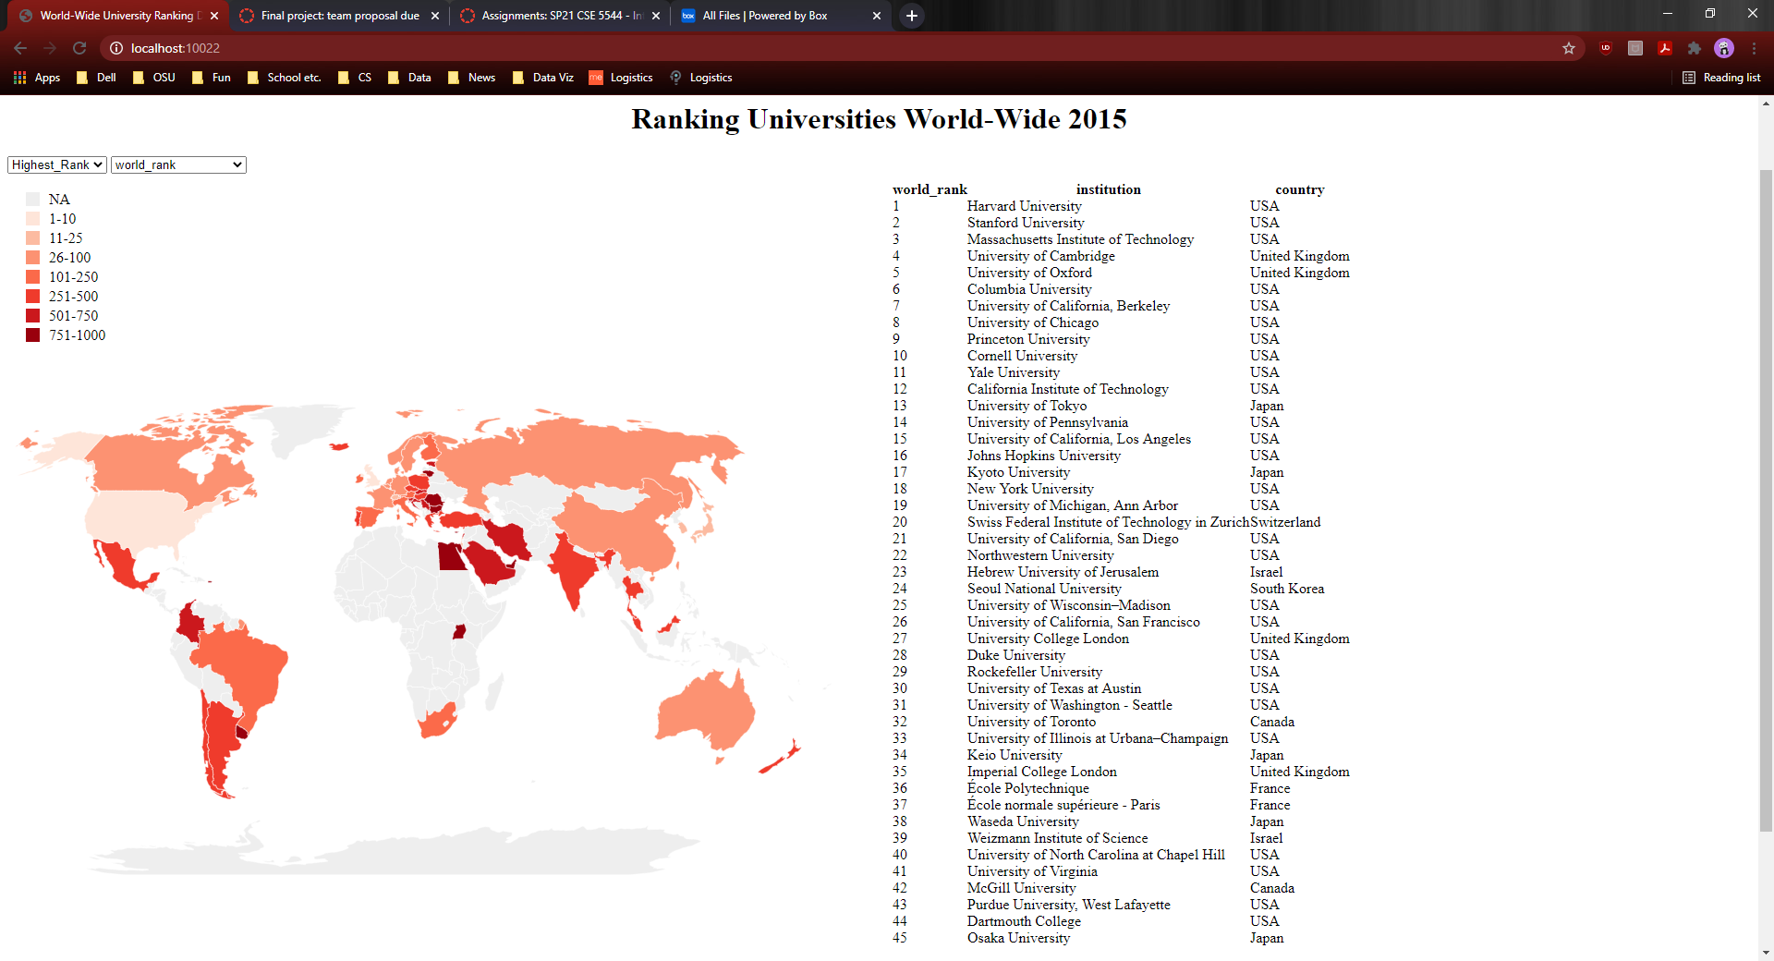
Final Implementation

Slide 8
Discussion
Improvements
Interaction component allows two layers of selecting a different view and answering different questions
Tasks all completed by final implementation
Incorporates visualization techniques we have learned about in class (luminance/color, interaction, etc.)
Replace the red scale in our geographic map with a green scale to allow better discernment by the human eye
Adding a search-for feature to find information about specific institutions
Adding a third visualization on the right-hand side with more information about a specific institution
Notes:
This project can lead to a number of realizations and conclusions
surrounding trends within university rankings. We are working with
an interesting and informative dataset and made some new
discoveries. We believe this will be delivered to our client for future
learning and we believe this will improve understanding surrounding
trends of the quality higher education.

Slide 9
Questions?

